Slide 1




ATDD
Web Test Automation
DEV3LSOLUTIONS.COM
LEANDOG.COM
Notes:
8 hours – 1 hour lunch break
7 hours = 420 minutes
10-minute break every hour
- Try to break on excersize to catch up anyone

Slide 2


Justin Beall
15 Years Software Engineering
CSM, A-CSD, CSPO, SA
Favorite language, Python
Notes:
2m : 2m

Slide 3
INTRODUCTIONS
Notes:
18m : 20m
Who are we?
Learning environment, feel free to ask questions.
What is everyone’s familiarity with the stack / software development.
Breakout rooms
Regular breaks – shoot for 10 till the hour, leaves room for questions and catch up as necessary
Who are you?
What do you do?
What do you want to learn in class?
Tell me about your automation experience

Slide 4
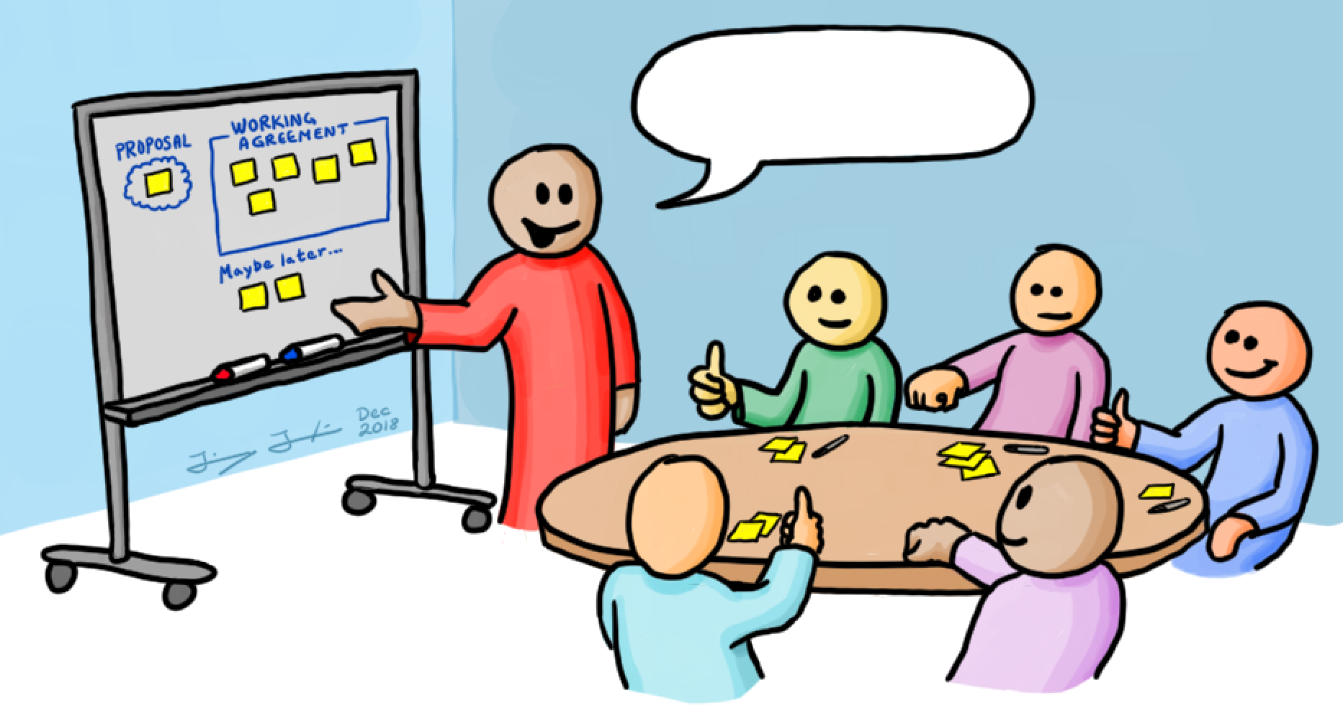

Working Agreements
Start / End Time
- Respect your peers; don’t be late
Be Present
- Participate
Own your learning
- Speak up if you don’t understand something
You aren’t done until the (virtual) person next to you is done
Code (1) Make it work; (2) Make it better
Notes:
5m : 25m

Slide 5

Why Are We Here?
Notes:
10m : 35m
How are releases performed currently?
Value Stream Map - where would the wait be?
What is testing at a higher level?
-- war stories

Slide 6

Course Objectives
Recognize Available ATDD Tools
Identify Gherkin Syntax
Practice with Automation Exercises
Integrate ATDD Into Daily Work
Notes:
5m : 40m

Slide 7

ATDD
Notes:
10m : 50m
Right to left perspective
ATDD is the consistent delivery of solutions that our customers love that fit the needs of the business
Unicorns

Slide 8
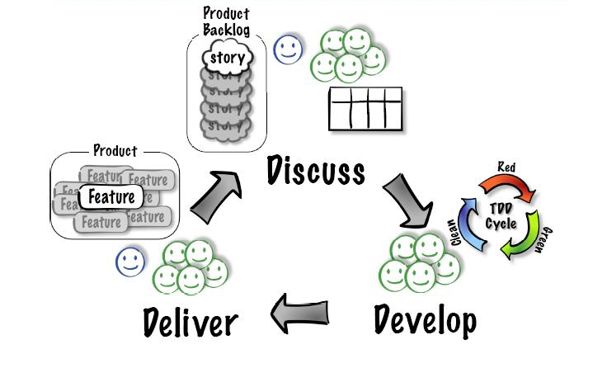
WHAT IS ATDD?
Notes:
15m : 65m
Acceptance Test Driven Development (ATDD) involves team members with different perspectives (customer, development, testing) collaborating to write acceptance tests in advance of implementing the corresponding functionality.
Despite the focus of this class, ATDD is much bigger and it’s major value prop is about the collaboration and definition of acceptance criteria with the automation being an added benefit.
Flow of ATDD
Discuss the highest priority story with Business, Design, Development and other stakeholder representation. (This is often referred as a 3 amigos meeting)
Out of this conversation the team will produce acceptance criteria in a simple, English like format called Gherkin (more on this later)
The team might also realize that this story is too big and needs to be split into multiple cards.
The team (most of the time developers and qa engineers) will take the Gherkin and then begin automating the tests and building the feature to satisfy the the acceptance test and unit tests (assuming TDD practices are being followed)
Once the team has satisfied all of the scenarios and steps outlined in the 3 amigos meeting (step 1), they will deliver the feature and do a show and tell.
Assuming the entire team, including the PO agrees that all acceptance criteria has been satisfied, the team pulls a new story and starts the cycle again.
Gherkin is used as a communication tool that leverages simple language and steps to ensure all team members are talking about the same thing and have the same understanding of the definition of done.

Slide 9

BREAK
Notes:
10m : 75m

Slide 10
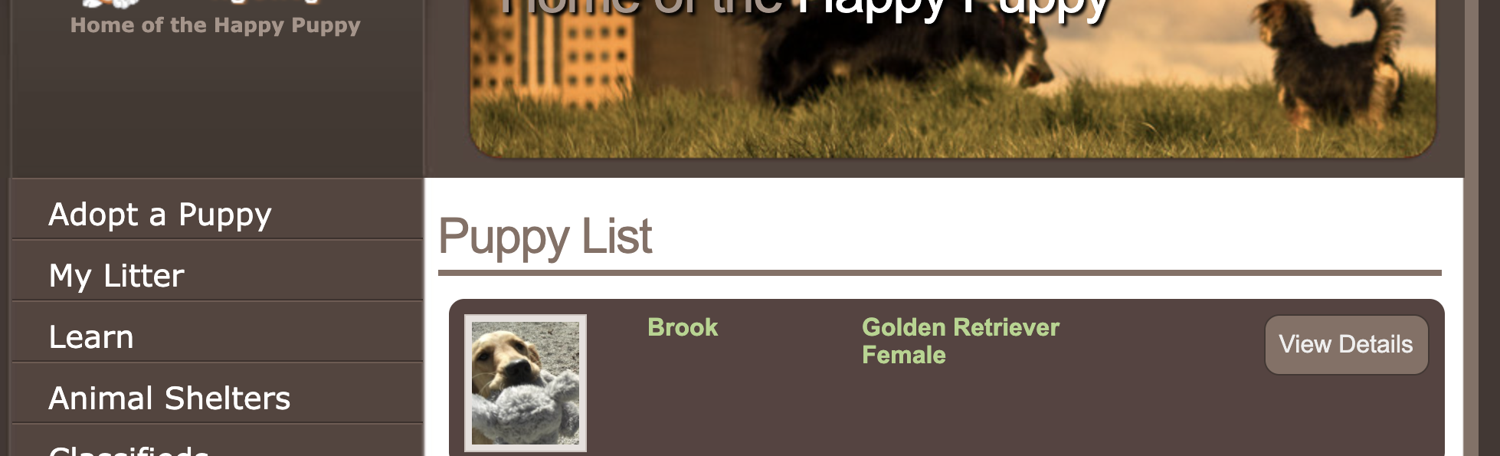
GHERKIN
Scenario: View the details of a puppy
Given I am on the home page
When I click on the puppy "Brook"
Then I see "Adopt Me!"
Notes:
10m : 85m
What is Gherkin?
Timebox this exercise for 10 minutes
Given / When / Then
Given – These steps are used to set up the initial state before you do your test
When – These steps are the actual test that is to be executed
Then – These steps are used to assert on the outcome of the test
Arrange / Act / Do
Make a peanut butter jelly?
Describe part of the product you are working on?

Slide 11
RUNNING TESTS
Manually
Local Automation
CI Build
00_typescript
Notes:
15m : 100m
Make sure everyone has computer configured and runnable.
If we run into problems, pair up and resolve the problems at lunch time.
Review TypeScript quickly.
Walk before you run.
How can we get started?
Make sure everyone can run TypeScript

Slide 12
WHERE DOES AUTOMATION
FIT INTO ATDD?
Notes:
5m : 105m
How often should tests be ran?

Slide 13

WHY USE AUTOMATION?
Repeatability / Idempotent
Computer does the work
Increases capacity
Reduced feedback and cycle time
Notes:
10m : 115m

Slide 14
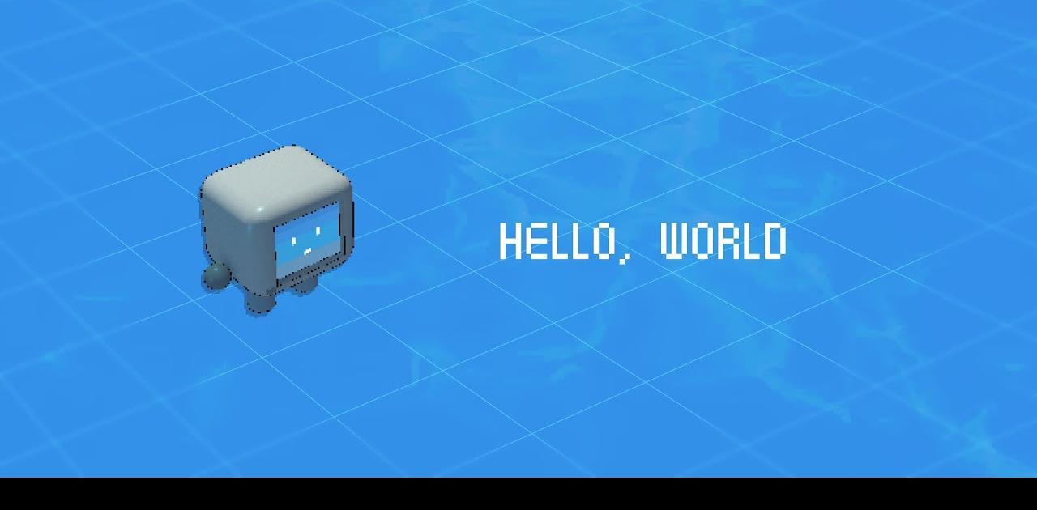
01_hello_world
Notes:
20m : 135m
Timebox this exercise for 15 minutes – Tour the hello world project
Make sure everyone has computer configured and runnable.
If we run into problems, pair up and resolve the problems at lunch time.
Make sure all can interactive debug a break point

Slide 15

BREAK
Notes:
10m : 145m

Slide 16
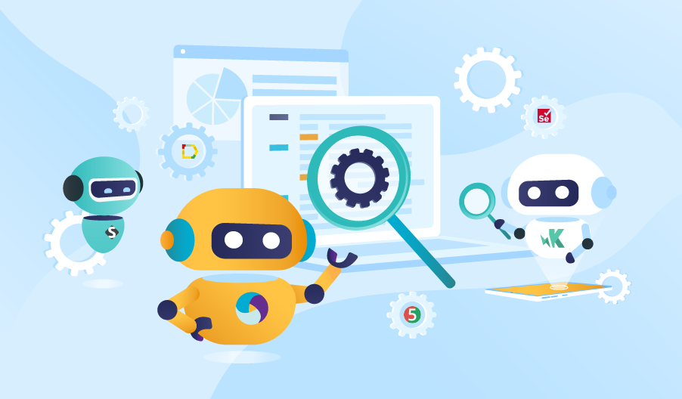
WEB TEST AUTOMATION TOOLS
GIVEN -> WHEN -> THEN PARSERS
Notes:
5m : 150m
Does anyone have familiarity with any automation tooling?

Slide 17

Cucumber JS
JavaScript-based implementation of Gherkin parser
Support for TypeScript
Integrates with Visual Studio Code
Notes:
5m : 155m

Slide 18
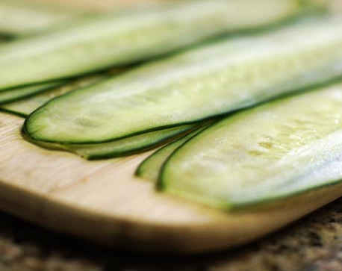
Cucumber.rb
Ruby-based
Original tool designed for parsing Given/When/Then tests (Gherkin)
Supported by RubyMine to write scenarios & run tests
Notes:
5m : 155m

Slide 19
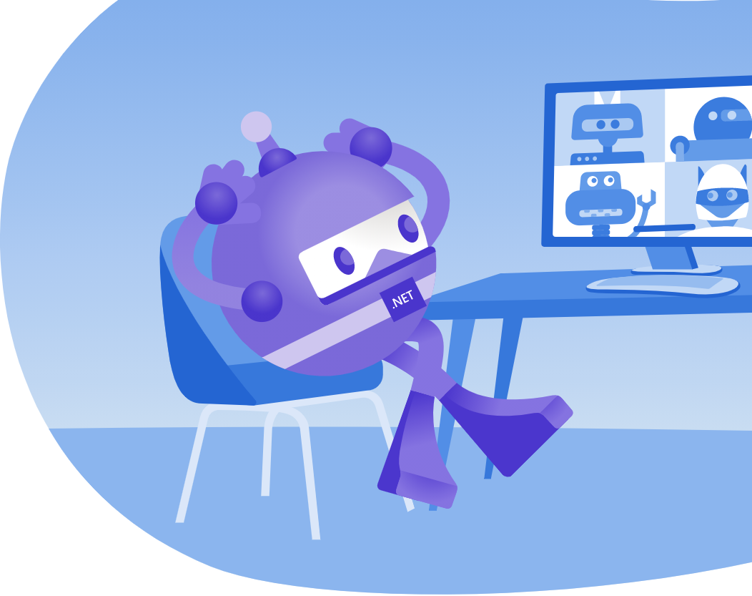
SpecFlow
Supports .NET, Xamarin and Mono
Uses official Given/When/Then Gherkin parser
Integrates with Visual Studio
Supports MSTest, NUnit, xUnit 2, and MbUnit
Notes:
5m : 155m

Slide 20

Cucumber JVM
Java-based implementation of Gherkin parser
Supports most of the popular languages for the JVM
Can integrate with Dependency Injection containers
Notes:
5m : 155m

Slide 21

Behave
Python-based implementation of Gherkin parser
Very similar usage to Ruby’s Cucumber
Notes:
5m : 155m

Slide 22

WEB TEST AUTOMATION TOOLS
BROWSER AUTOMATION
Notes:
5m : 160m

Slide 23

SELENIUM
First of second-generation Browser automation tools
Can drive browsers using many different languages - C#, Python, Ruby, Perl, PHP, & JavaScript
Now leverages the WebDriver API
Notes:
2.5m : 162.5m
Not the same as the Selenium IDE Record-Playback tool

Slide 24

PROTRACTOR
End-to-end behavior-driven testing framework
Designed keeping Angular JS applications in mind
Combining powerful technologies such as Jasmine, Selenium Webdriver, Node.js
Notes:
2.5m : 165m
What is Protractor?
The Protractor is an automation testing tool for web applications testing; combining powerful technologies such as Jasmine, Selenium Webdriver, Node.js etc.
The Protractor testing tool is an end to end behavior-driven testing framework designed keeping Angular JS applications in mind. Even though that might sound like Protractor won’t work with non-angular JS applications, it does.
It works with both Angular and non-Angular JS applications equally well.

Slide 25

WATIR
Web Application Testing in Ruby
Originally automated IE through COM
Later updated to use web drivers like Selenium under the hood in 2009
Automates Internet Explorer, Firefox and Chrome (using Chrome Driver)
Notes:
2.5m : 165m
cliec was the first tool (that I’m aware of) for automating a browser from a general-purpose programming language. cliec led to WTR which led to WATiR. Originally WATiR only worked with IE but had ports to later projects. In 2009 WATiR was ported to the WebDriver spec and began using tools like Selenium instead of driving browsers directly. Selenium was inspired by WATiR and was the first cross platform browser automation tool.

Slide 26

Puppies Scenario
02_puppies puppies.feature
Notes:
20m : 185m
Timebox this exercise for 20 minutes
Presenter goes through the 1st adopt_puppies.feature scenario with the class. The class is your “pair.” Timebox this exercise for 15 minutes Scenario: #1 Be able to view the details of a puppy
Given I am on the home page
When I click on the puppy "Brook"
Then I see "Adopt Me!”
POSSIBLE SOLUTION:
import { $, element, by, ElementFinder, browser } from 'protractor';
import { Given, When, Then } from 'cucumber';
const chai = require('chai').use(require('chai-as-promised'));
const expect = chai.expect;
Given(/^I am on the home page$/, async () => {
let expectedTitle = "Sally's Puppy Adoption Agency";
await browser.get('http://localhost:3000');
await expect(browser.getTitle()).to.eventually.equal(expectedTitle);
});
When(/^I click on the puppy "(.*?)"$/, async (puppyName) => {
let puppyList = await element.all(by.className('puppy_list'));
var puppy: ElementFinder;
for (let index in puppyList) {
let puppyElement = puppyList[index];
let rowText = await puppyElement.getText();
if (rowText.includes(puppyName)) {
puppy = puppyElement;
break;
}
}
let viewDetails = await puppy.element(by.className('rounded_button'));
await viewDetails.click();
});
Then(/^I see "(.*?)"$/, async (text) => {
let buttons = await element.all(by.className('rounded_button'));
let isFound = false;
for (let index in buttons) {
let button = buttons[index];
let rowText = await button.getAttribute('value');
if (rowText.includes(text)) {
isFound = true;
break;
}
}
expect(isFound).to.be.true;
});

Slide 27

PROJECT STRUCTURE
Notes:
20m : 205m
Explain here why we have the folder structure in the project:
features - main folder containing the gherkin “feature” files that have scenarios defined within them
step_definitions - contains the Ruby code that is executed based on the gherkin scenarios, this is the “bridge” between the gherkin and executable code
support - has the global environment and helper files generated by Cucumber. Any additional helper files (hooks, etc) are usually kept here.
This is the minimum structure, devs can further organize their files & features within these folders.

Slide 28

BREAK
Notes:
10m : 215m

Slide 29

NEXT TWO SCENARIOS
03_puppies puppies.feature Scenarios #2 & #3
Notes:
30m : 245m
Class goes through 2nd & 3rd adopt_puppies.feature scenarios. Presenter is available for questions. Timebox this exercise for 30 minutes (15 per scenario)
Scenario: #2 Be able to return to the view of all available puppies
Given I am on the home page
When I click on the puppy "Brook"
And I click on "Return to List"
Then I see the home page
Scenario: #3 Be able to add the puppy to adopt later
Given I am on the home page
When I click on the puppy "Brook"
And I click on "Adopt Me!"
Then I see the puppy "Brook" is in my litter

Slide 30

Review
Notes:
10m : 255m
What went well?
What didn’t go well?
puppies.feature. Timebox this exercise for 15 minutes
POSSIBLE SOLUTION:
When(/^I click on "([^"]*)"$/) do |caption|
element = @browser.links(text: caption)[0]
element = @browser.buttons(text: caption)[0] unless element.exist?
element.click
end
Then(/^I see the puppy "([^"]*)" is in my litter$/) do |name|
expect(@browser.h2(text: "#{name}:").exist?).to be true
end

Slide 31
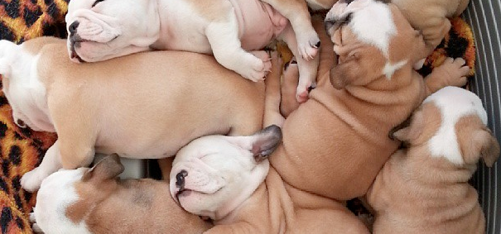
COMPOUND STEP SCENARIO
04_compound puppies.feature Scenario #3 (#4/#5)
Notes:
20m : 275m
In Cucumber-JVM calling steps from step definitions is not supported; this is by design.
The best way to achieve composition and reuse, is to use the features of your programming language. If you want to combine several actions into one step, extract individual (helper) methods and call these methods from your step definition.
You want to strive to keep your steps atomic as much as possible.
Presenter goes through the 4th adopt_puppies.feature scenario with the class.
Scenario has a Given that rolls up a few previous Given steps
Scenario: #4 Be able to change my mind about adopting a puppy
Given I have added a puppy to my litter
When I click on "Change your mind"
Then I see the home page
POSSIBLE SOLUTION
Given(/^I have added a puppy to my litter$/) do step 'I am on the home page' step 'I click on the puppy "Brook"' step 'I click on "Adopt Me!"' end

Slide 32

BREAK
Notes:
10m : 285m

Slide 33

NEXT TWO SCENARIOS
04_compound puppies.feature Scenario #3 (#4/#5)
Notes:
30m : 315m
Class goes through 5th & 6th puppies.feature scenarios.
Presenter is available for questions.
Timebox this exercise for 30 minutes
@Scenario
Scenario: Add another puppy to my litter
Given I have added the puppy "Brook" to my litter
When I click on "Adopt Another Puppy" in litter
And I click on the puppy "Ruby Sue"
And I click on "Adopt Me!"
Then I see the puppy "Ruby Sue" is in my litter
@Scenario
Scenario: Change my mind removes all puppies from my litter
Given I have added the puppy "Brook" to my litter
And I click on "Adopt Another Puppy"
And I click on the puppy "Ruby Sue"
And I click on "Adopt Me!"
When I click on "Change Your Mind" in litter
Then I return to the home page
And I see "Your cart is currently empty"

Slide 34

LET’S REVIEW!
Notes:
15m : 330m
Presenter reviews solution(s) to scenarios 5-6 of adopt_puppies.feature. Timebox this exercise for 15 minutes

Slide 35

BREAK
Notes:
10m : 340m

Slide 36
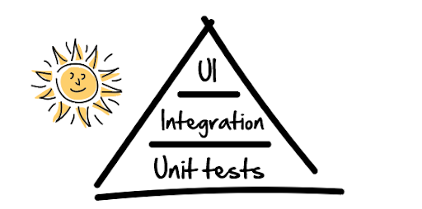
Testing Pyramid
Notes:
10m : 350m
Review what automation has given us
Discuss how automation frees up for higher level tasks
Look at the puppy site, and talk about what Exploratory Testing could be done around the features we have
Extra time up front to save exponential time in the future
How to handle different suites to run for different scenarios - Developer Machine
- CI
- Regression

Slide 37
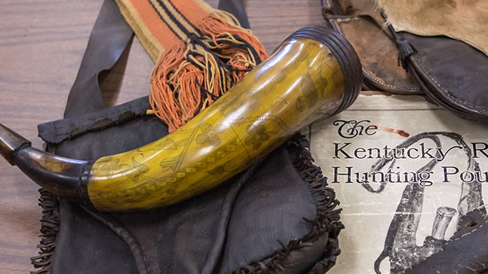
TAGS & COMMAND LINE
Notes:
10m : 360m
Presenter discusses how tags work, how we can include/exclude features & scenarios from test runs with tags, Estimated length of this exercise is 10 minutes

Slide 38

TAGS
Tags are prepended with @ sign - @important @ignore
Can be used to define special behavior in tests
Can be used for test in/exclusion
Notes:
2.5m : 357.5m

Slide 39
USAGE OF TAGS
@ignore
Scenario: See the details of a puppy
Given I am on the home page
When I click on the puppy "Brooke"
Then I see "Adopt Me!"
Notes:
2.5m : 360m
Can put before a Feature or Scenario

Slide 40
TAGS & HOOKS
Before({tags: "@foo"}, function () { // This hook will be executed before
// scenarios tagged with @foo });
Notes:
2.5m : 362.5m
Can also AND or OR hooks together
Works for all types of Hooks: Before, After, AfterStep, Around
For OR tags, pass the tags in a single string comma separated:
Before('@cucumis, @sativus') do # This will only run before scenarios tagged # with @cucumis OR @sativus. end
For AND tags, pass the tags as separate tag strings:
Before('@cucumis', '~@sativus') do # This will only run before scenarios tagged # with @cucumis AND NOT @sativus. end
You create complex tag conditions using both OR and AND on tags:
Before('@cucumis, @sativus', '@aqua') do # This will only run before scenarios tagged # with (@cucumis OR @sativus) AND @aqua end

Slide 41
TAGS & COMMAND LINE
protractor conf.js --cucumberOpts.tags="@onlyRunThis"
Notes:
2.5m : 365m
Tags can also be defined as part of a cucumber.yml file in a project. We do have an example of this file in the atdd-with-puppies project that can be shown to participants.
Can also add multiple tags include/exclude to command line call.
Super useful for development flow to only run test(s) you are focusing on
You can implement Scenario #7 like I did… or put an @ignore tag above Scenario #7

Slide 42

DAY 1 - WRAP UP!
Notes:
30m : 395m
Retrospective
---
25m remaining buffer for late starts from breaks, student help, hiccups in general

Slide 43

Day Two
Notes:
10m : 10m
Socialize

Slide 44

RECAP
Notes:
15m : 25m
ATDD – Ask for volunteer someone explain ATDD in their own words
Gherkin – What is gherkin, and why go through the trouble of automating business language?
Automation – Describe in your own words how automation fits into ATDD
Our Stack – TypeScript + Protractor (Selenium Web Driver) + CucumberJs
Puppies Site – Review, features
- ATDD like TDD but applied to the level of features
- Natural language to create some examples Gherkin
- Scenarios are examples of how application should behave from standpoint of user
Given Login, Valid/Invalid Credentials, Then I log in/see an error Developers wire code to natural language
- Executable documentation – Every change ever made gets verified
Lot of hard work and discipline – shift quality left

Slide 45
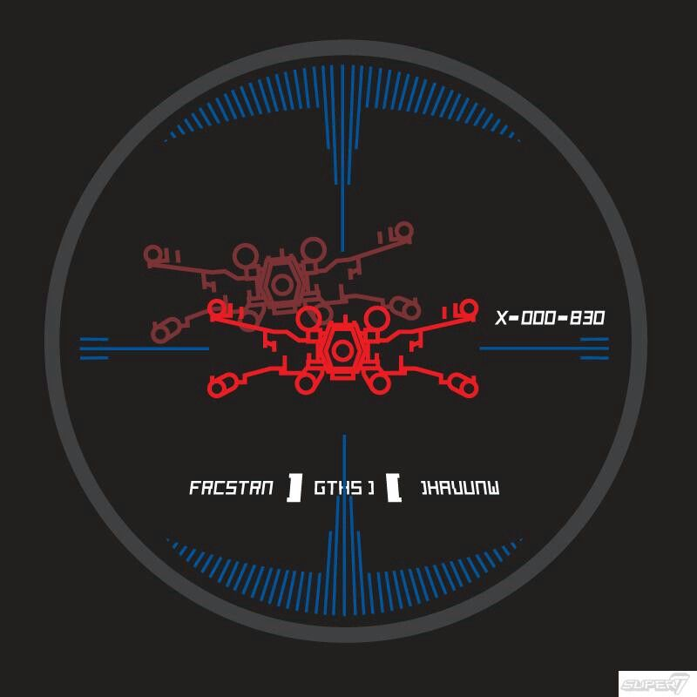
Course Objectives
Recognize Available ATDD Tools
Identify Gherkin Syntax
Practice with Automation Exercises
Integrate ATDD Into Daily Work
Notes:
10m : 35m
How are we doing?

Slide 46
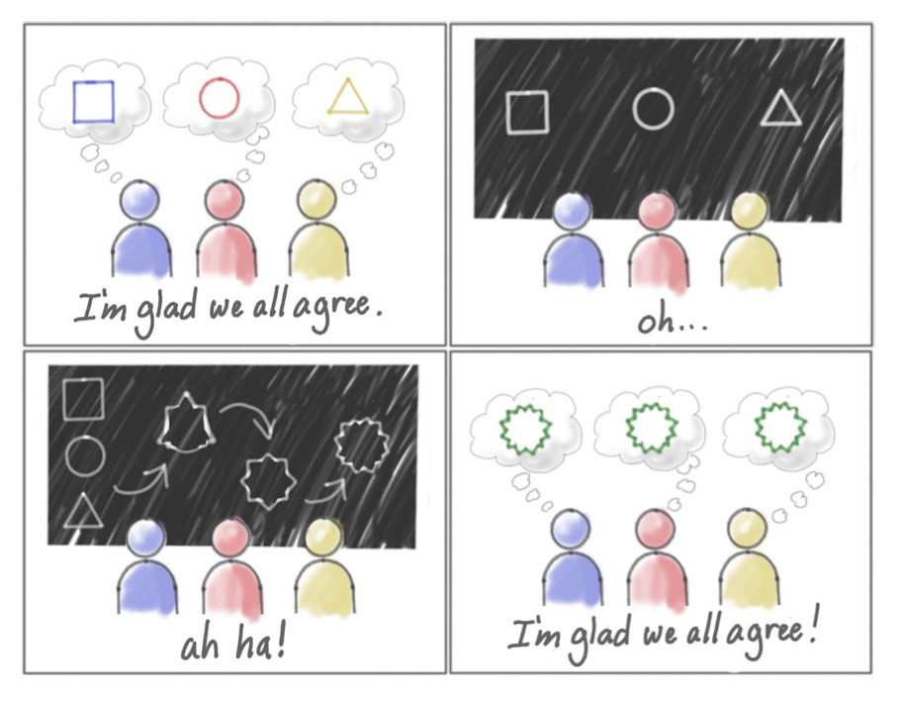
Shared Understanding
Notes:
10m : 45m
Has anyone ever experienced the first slide?
How does ATDD help facilitate shared understanding?
Gherkin becomes the common medium between all parties
Becomes an encyclopedia for the application

Slide 47
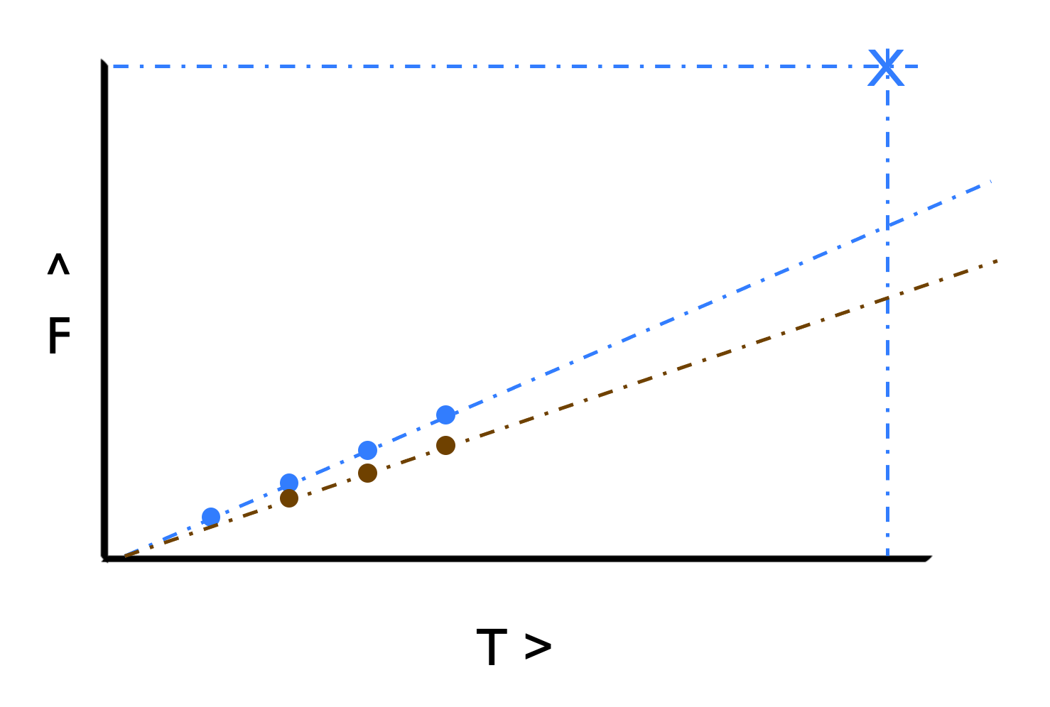
Blue Planned Red Actual
WASTE
Notes:
5m : 50m
Even if you are unit testing and working iteratively, we can still have an incomplete understanding of the definition of done.
Rework is required to correct this misunderstanding. The resulting loss of features is a result of missed understanding of the desired behavior.
Rework due to not understanding the requirements
Unclear Definition of Done
Over building
Under building

Slide 48
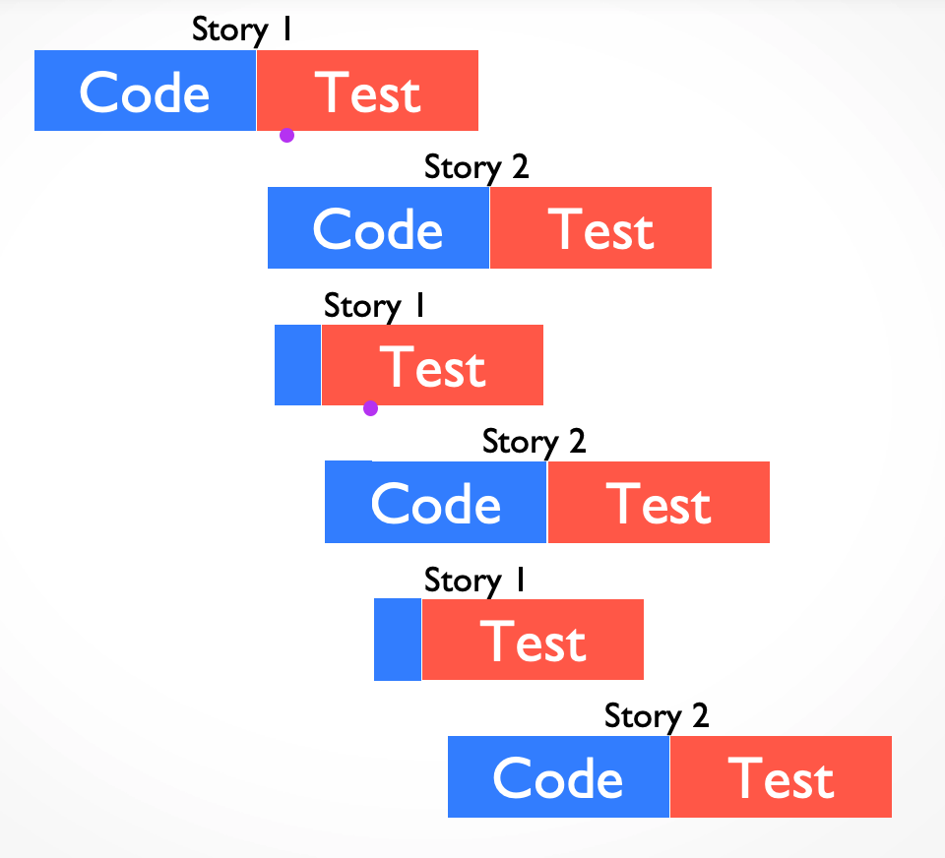
REWORK
Notes:
5m : 55m
Let’s look at how code-then-test affects potential rework.
Overall, rework causes the timeline to slip.
Additionally, the “context switch” of changing tasks has a cost for both the developers and the testers.

Slide 49

Definition of Done
Notes:
5m : 60m
What does “done” mean? -- Keep in mind “shared understanding”
If this was our product, is this bathroom “done”? Why or why not?
The Definition of Done defines a common terminology to be used between all members (internal and external) of the team. Once defined, no one ever has to ask if something is "DONE-done" ever again!
Definition
The team agrees on, and displays prominently somewhere in the team room, a list of criteria that must be met before a product increment "often a user story" is considered "done". Failure to meet these criteria at the end of a sprint normally implies that the work should not be counted toward that sprint's velocity.
Benefits
Provides Explicit Accountability
Every user story moved into the "Done" category meets a minimum agreed-upon standard of completion
Creates an Overwhelming Sense of Clarity and Power
Prevents User Story Thrashing
Limits the Risk of Misunderstanding and Conflict
Between the development team, quality assurance, and the product owner
Guides Pre-Implementation Activities
Discussion, estimation, design
Example Checklist:
Code Updated to satisfy all requirements and acceptance criteria
Code Properly Formatted and follows applicable standards
Code self-documented
Code Review Performed
Exit Three Amigos Completed
Unit, Integration, and Acceptance Tests Added/Updated
Pass successfully
Provide adequate code coverage
Documentation Created (Architectural / Design ) and made available as appropriate
Performance concerns have been identified, analyzed, and addressed
Security concerns have been identified, analyzed, and addressed
Metrics have been identified and addressed
Code Accepted by QA
User Story Status Updated
Set to "Done"

Slide 50

Planning Exercise
Pick Instagram, Twitter, or Facebook as a team product
- Identify some existing features
- Pick a feature and write some scenarios
- Write Gherkin (Given/When/Then) for each scenario
Notes:
20m

Slide 51

Notes:
10m : 70m

Slide 52

PAGE OBJECT PATTERN
Pattern that represents HTML pages as objects
Encapsulate functionality of a page
One place to change if HTML structure changes
Expose page functionality as services
Notes:
20m : 370m
Discuss how we have evolved from inline elements to page objects, then extracted a base class where most of functionality exists
PAGEOBJECT - SHARED SERVICES
Menus and other common controls can be modelled using modules or base classes
PAGEOBJECT - SERVICES
Class properties could return strings for dynamic text in page, contents of tables, etc
Class methods allow you to take action on the page, and could return new PageObjects, booleans, etc.

Slide 53

CALCULATED ELEMENT SCENARIO
05_calculated puppies.feature Scenario #7
Notes:
15m : 85m
Presenter goes through the 7th puppies.feature scenario with the class
Scenario: Litter Price includes accessories
Given I have added the puppy "Brook" to my litter
When I add a "collar" to my order
And I add a "toy" to my order
Then I see "$63.93"

Slide 54

NEXT SCENARIO
05_calculated puppies.feature Scenario #7
Notes:
30m : 115m
Class implements calculated example
Presenter is available for questions

Slide 55
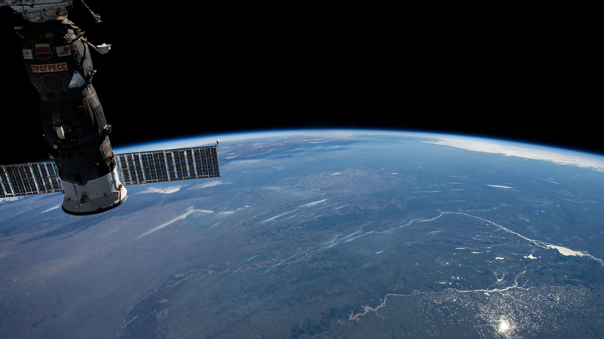
LET’S REVIEW!
Notes:
15m : 130m
Presenter reviews solution(s) to scenario 7 of puppies.feature

Slide 56

Notes:
10m : 140m

Slide 57
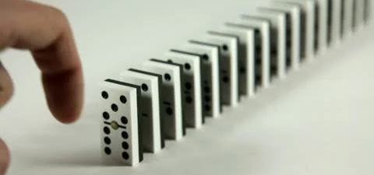
TEST FIXTURES & DATA MANAGEMENT
Notes:
10m : 380m
Docker has startup script
Idempotent tests
HOW DO YOU MANAGE TEST DATA?
SQL scripts?
Backups?
Don’t do it at all?

Slide 58

DATA TABLE SCENARIO
06_data_table contact.feature Scenario #1
Notes:
15m : 155m
Presenter goes through the contact.feature scenario with the class
Scenario requires a data table to plug entries into a form.
Feature: Contact us
@Scenario
Scenario: Submit a message
Given I am on the home page
When I click on the email icon
And I fill the form in with the following values
| contact_message_name | Sad Puppy |
| contact_message_email | puppy@puppy.com |
| contact_message_body | I am having trouble adopting a puppy. Please help! |
And I click on "Send"
Then I see "Thank you for contacting us!"
SOLUTION:
When(/^I click on the email icon$/) do @browser.link(name: "contact").click end
When(/^I fill the form in with the following values:$/) do |table| table.hashes.each do |data| selector = {id: data['element']} value = data['value'] set_field(selector, value) end end
def set_field(selector, value)
@browser.element(selector).wait_until_present
if @browser.text_field(selector).exists?
@browser.text_field(selector).set(value)
elsif @browser.textarea(selector).exists?
@browser.textarea(selector).set(value)
else
@browser.select_list(selector).select_value(value)
end
end

Slide 59

NEXT SCENARIO
06_data_table contact.feature Scenario #1
Notes:
30m : 185m
Class goes through contact.feature scenario.
Presenter is available for questions
Feature: Contact us
@Scenario
Scenario: Submit a message
Given I am on the home page
When I click on the email icon
And I fill the form in with the following values
| contact_message_name | Sad Puppy |
| contact_message_email | puppy@puppy.com |
| contact_message_body | I am having trouble adopting a puppy. Please help! |
And I click on "Send"
Then I see "Thank you for contacting us!"

Slide 60

LET’S REVIEW!
Notes:
10m : 200m
Presenter reviews solution(s) to scenario 8 of adopt_puppies.feature. Timebox this exercise for 15 minutes
POSSIBLE SOLUTION:
When(/^I fill the form in with the following values:$/) do |table| table.hashes.each do |data| selector = {id: data['element']} value = data['value'] set_field(selector, value) end end
def set_field(selector, value)
@browser.element(selector).wait_until_present
if @browser.text_field(selector).exists?
@browser.text_field(selector).set(value)
elsif @browser.textarea(selector).exists?
@browser.textarea(selector).set(value)
else
@browser.select_list(selector).select_value(value)
end
end

Slide 61

BREAK
Notes:
10m : 210m

Slide 62

SCENARIO OUTLINES
07_outlines order.feature Scenario
Notes:
15m : 225m
Presenter goes through the order.feature scenarios with the class
Scenario requires an outline to plug entries into a form.
Scenario Outline: #3 All fields are required to send a message to the agency
Given I am on the home page
When I click on the email icon
And the contact form is completely filled in
But I blank out "<element>"
And I click on "Send"
Then I see "<error>"
Examples:
| element | error |
| contact_message_name | Name can't be blank |
| contact_message_email | Email can't be blank |
| contact_message_body | Body can't be blank |
POSSIBLE SOLUTION:
When(/^the contact form is completely filled in$/) do steps %Q{ And I fill the form in with the following values: | element | value | | contact_message_name | Name can't be blank | | contact_message_email | Email can't be blank | | contact_message_body | Body can't be blank | } end When(/^I blank out "(.*)"$/) do |element| set_field({id:element}, '') end

Slide 63

NEXT SCENARIO
07_outlines order.feature
Notes:
15m : 225m
Presenter goes through the order.feature scenarios with the class
Scenario requires an outline to plug entries into a form.
Scenario Outline: #3 All fields are required to send a message to the agency
Given I am on the home page
When I click on the email icon
And the contact form is completely filled in
But I blank out "<element>"
And I click on "Send"
Then I see "<error>"
Examples:
| element | error |
| contact_message_name | Name can't be blank |
| contact_message_email | Email can't be blank |
| contact_message_body | Body can't be blank |
POSSIBLE SOLUTION:
When(/^the contact form is completely filled in$/) do steps %Q{ And I fill the form in with the following values: | element | value | | contact_message_name | Name can't be blank | | contact_message_email | Email can't be blank | | contact_message_body | Body can't be blank | } end When(/^I blank out "(.*)"$/) do |element| set_field({id:element}, '') end

Slide 64

LET’S REVIEW!
Notes:
15m : 270m
Presenter goes through the order.feature scenarios with the class
POSSIBLE SOLUTION:
When(/^the order form is completely filled in$/) do steps %Q{ And I fill the form in with the following values: | element | value | | order_name | Joe Sixpack | | order_address | 123 Main St. | | order_email | joe@sixpack.com | | order_pay_type | Check | } end When(/^I leave (.*) blank$/) do |element| set_field({id:element}, '') end

Slide 65

BREAK
Notes:
10m : 280m

Slide 66

SCENARIO BACKGROUND
08_background contact.feature
Notes:
15m : 295m
Presenter goes through the contact.feature scenario with the class, refactoring the first 2 steps into a Background.
Background runs before every scenario, but after any Before hooks.
Remove the @ignore tag from Scenario #1
Move first 2 steps into a Background
Background:
Given I am on the home page
When I tap on the email icon
Remove those steps from Scenario #1

Slide 67
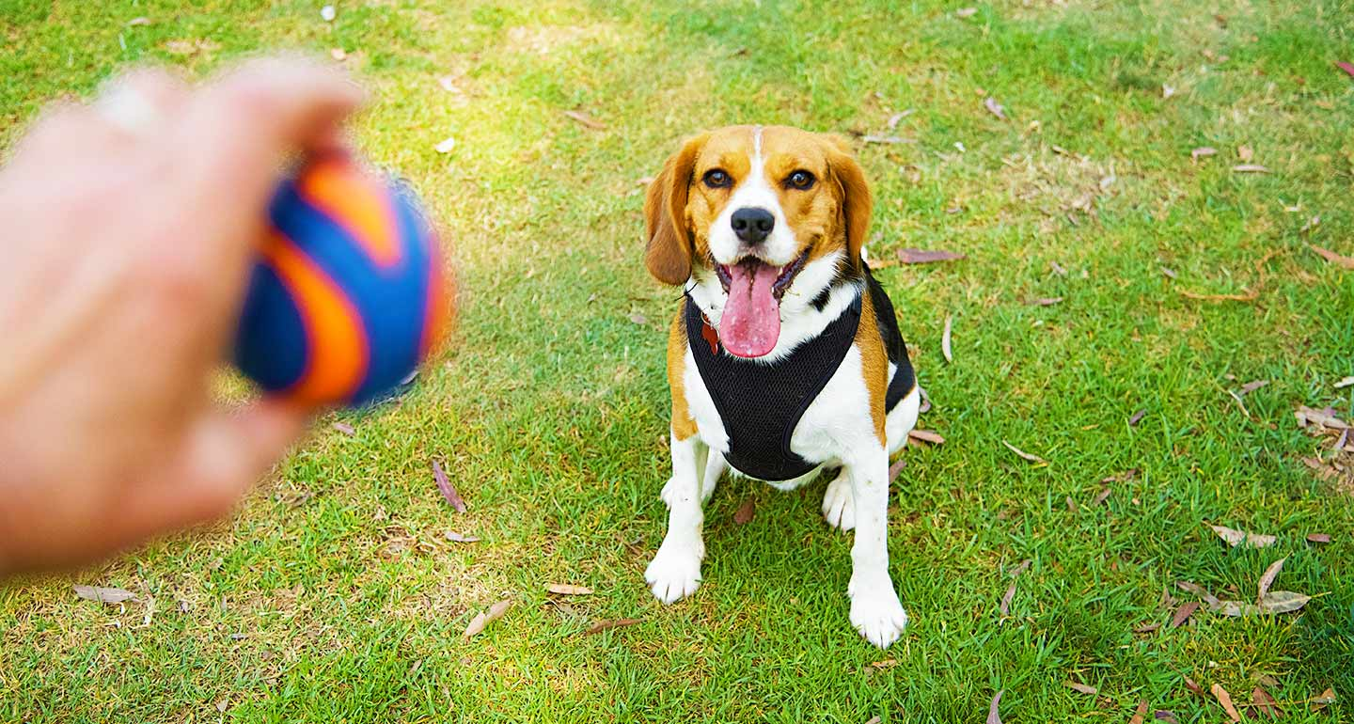
NEXT SCENARIO
08_backgrounds contact.feature
Notes:
30m : 325m
Class goes through contact.feature . Presenter is available for questions.
What else could be cleaned up in this project?
Background runs before every scenario, but after any Before hooks.
Remove the @ignore tag from Scenario #1
Move first 2 steps into a Background
Background:
Given I am on the home page
When I tap on the email icon
Remove those steps from Scenario #1

Slide 68

LET’S REVIEW!
Notes:
15m : 340m
Presenter reviews solution(s) to 1st discussion_board.feature scenario. Timebox this exercise for 15 minutes
POSSIBLE SOLUTION:
Then(/^I see the heading "([^"]*)"$/) do |text|
expect(@browser.div(id: 'content').h2().text.include?(text)).to be true
end

Slide 69

BREAK
Notes:
10m : 350m

Slide 70

THE END
Notes:
30m : 410m
Course Objectives
Recognize Available ATDD Tools
Identify Gherkin Syntax
Practice with Automation Exercises
Integrate ATDD Into Daily Work
Retrospective

